Slide 1
Experimental Details for Blinded Healthy and Breast Cancer Plasma Samples
Used samples: 36-45
Plasma volume: 20 µl.
Type of Cancer: Lung cancer H460
Concentration: unknown.
Size Distribution: unknown.
Experimental duration: 60 min.
Antibody used: CD9, CD81, and CD63.

Slide 2
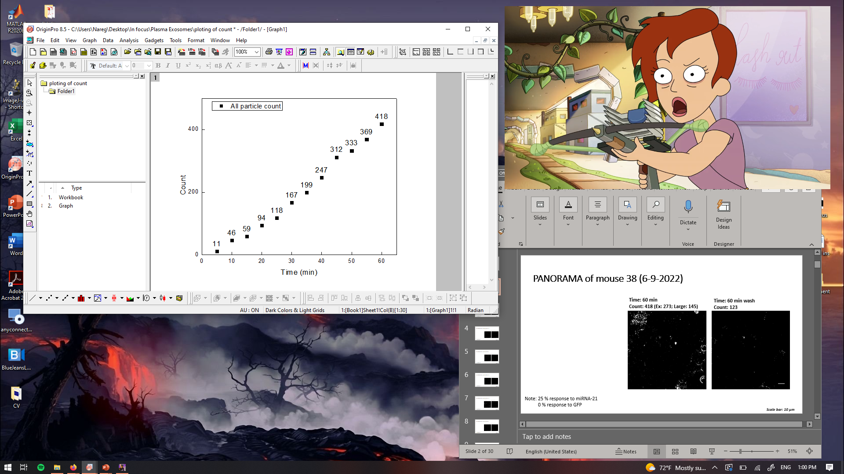
PANORAMA of mouse 38 (6-9-2022)
Time: 60 min
Count: 418 (Ex: 273; Large: 145)
Time: 60 min wash
Count: 123
Note: 25 % response to miRNA-21
0 % response to GFP
Scale bar: 10 µm

Slide 3
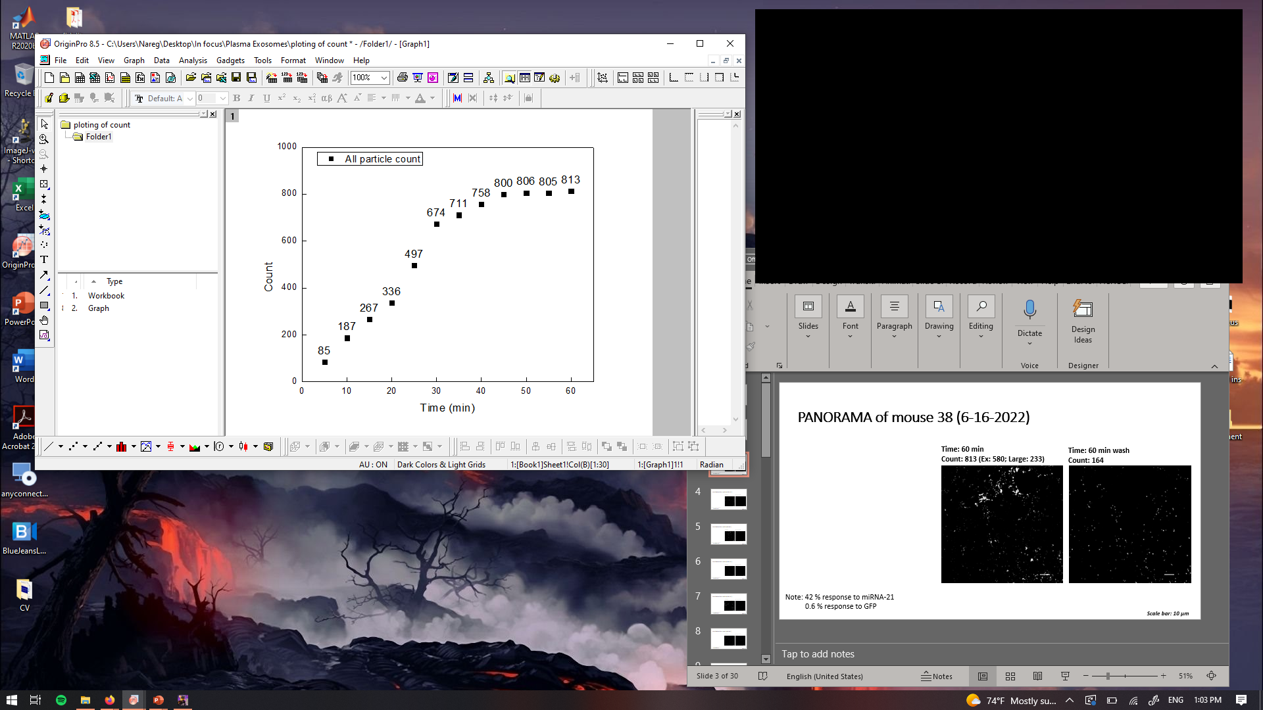

PANORAMA of mouse 38 (6-16-2022)
Time: 60 min
Count: 813 (Ex: 580; Large: 233)
Time: 60 min wash
Count: 164
Note: 42 % response to miRNA-21
0.6 % response to GFP
Scale bar: 10 µm

Slide 4
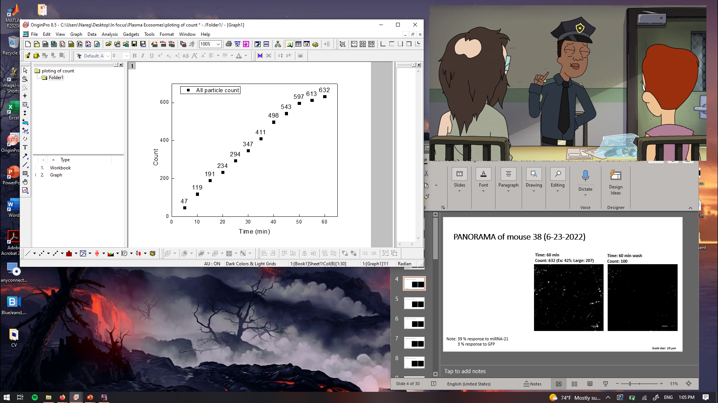

PANORAMA of mouse 38 (6-23-2022)
Time: 60 min
Count: 632 (Ex: 425; Large: 207)
Time: 60 min wash
Count: 100
Note: 39 % response to miRNA-21
3 % response to GFP
Scale bar: 10 µm

Slide 5
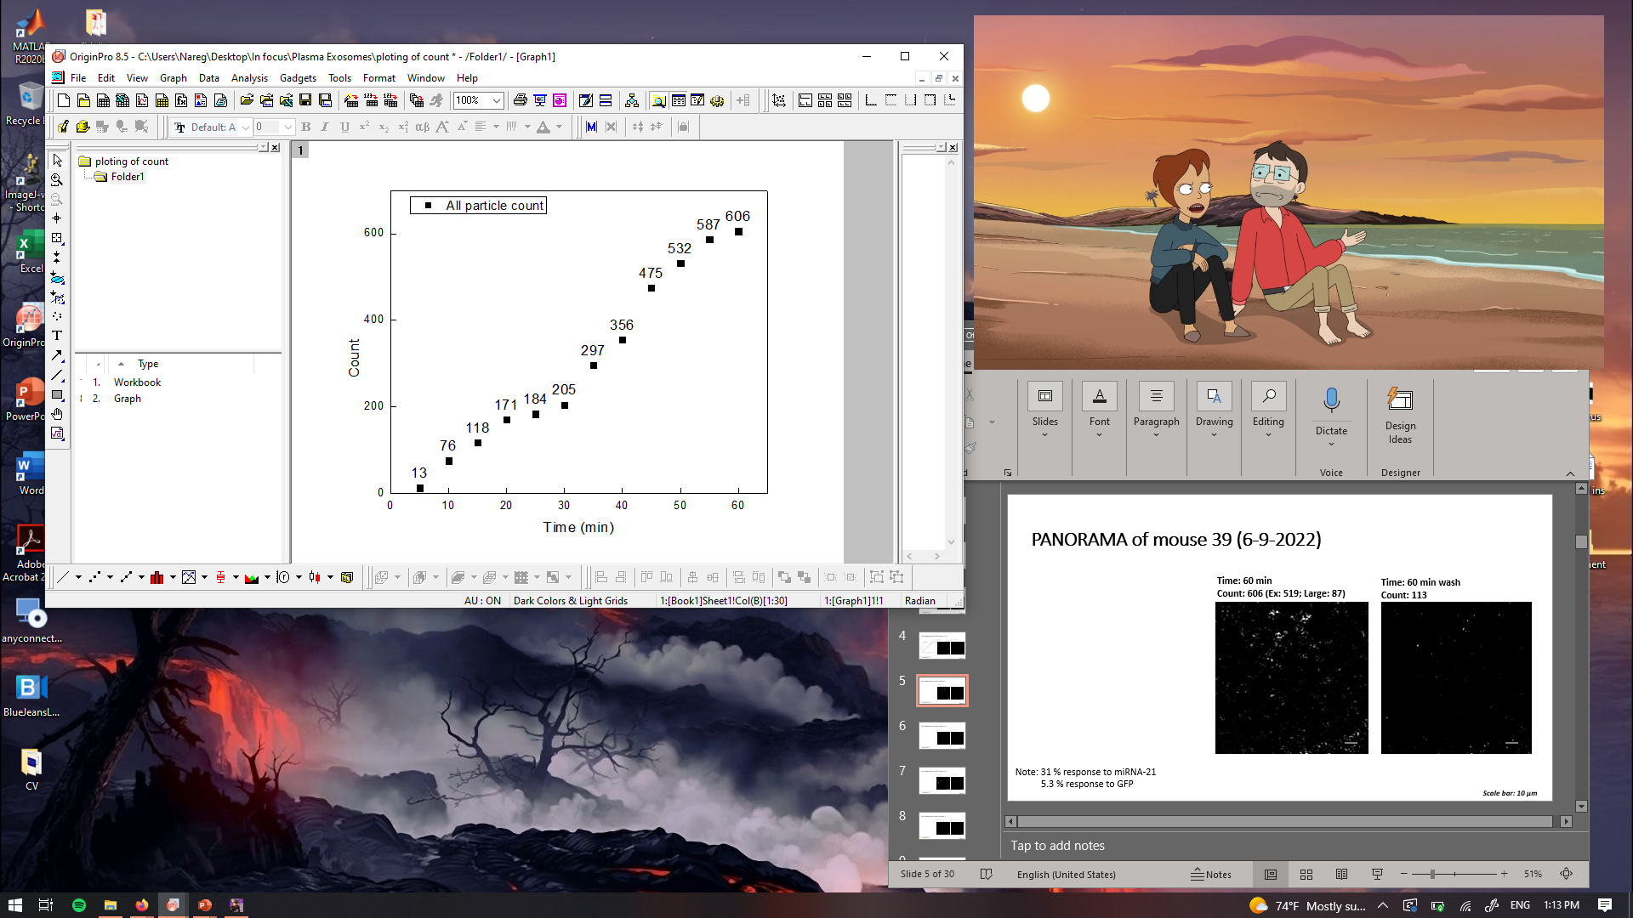
PANORAMA of mouse 39 (6-9-2022)
Time: 60 min
Count: 606 (Ex: 519; Large: 87)
Time: 60 min wash
Count: 113
Note: 31 % response to miRNA-21
5.3 % response to GFP
Scale bar: 10 µm

Slide 6
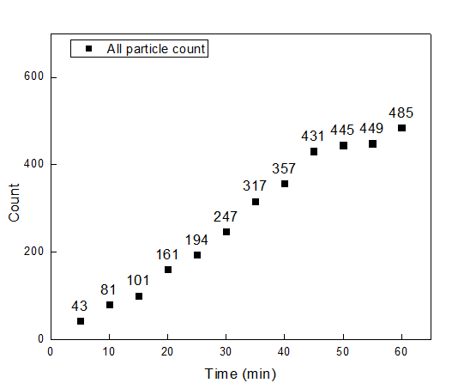


PANORAMA of mouse 39 (6-16-2022)
Time: 60 min
Count: 485 (Ex: 406; Large: 79)
Time: 60 min wash
Count: 109
Note: 29 % response to miRNA-21
0 % response to GFP
Scale bar: 10 µm

Slide 7
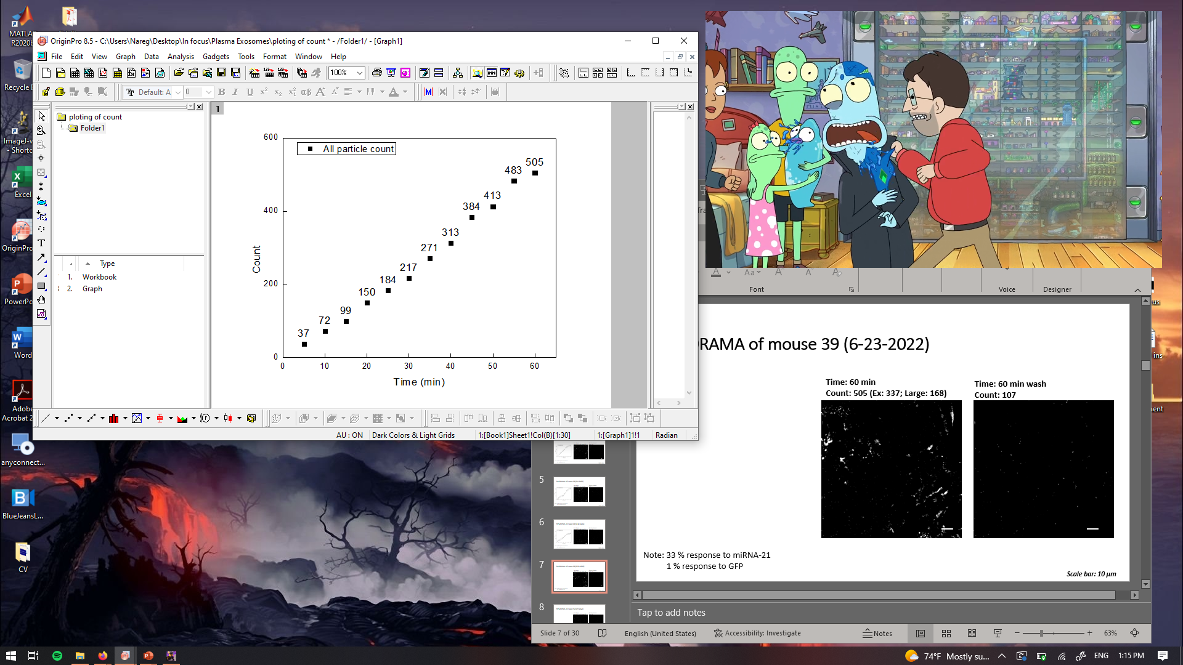
PANORAMA of mouse 39 (6-23-2022)
Time: 60 min
Count: 505 (Ex: 337; Large: 168)
Time: 60 min wash
Count: 107
Note: 33 % response to miRNA-21
1 % response to GFP
Scale bar: 10 µm

Slide 8
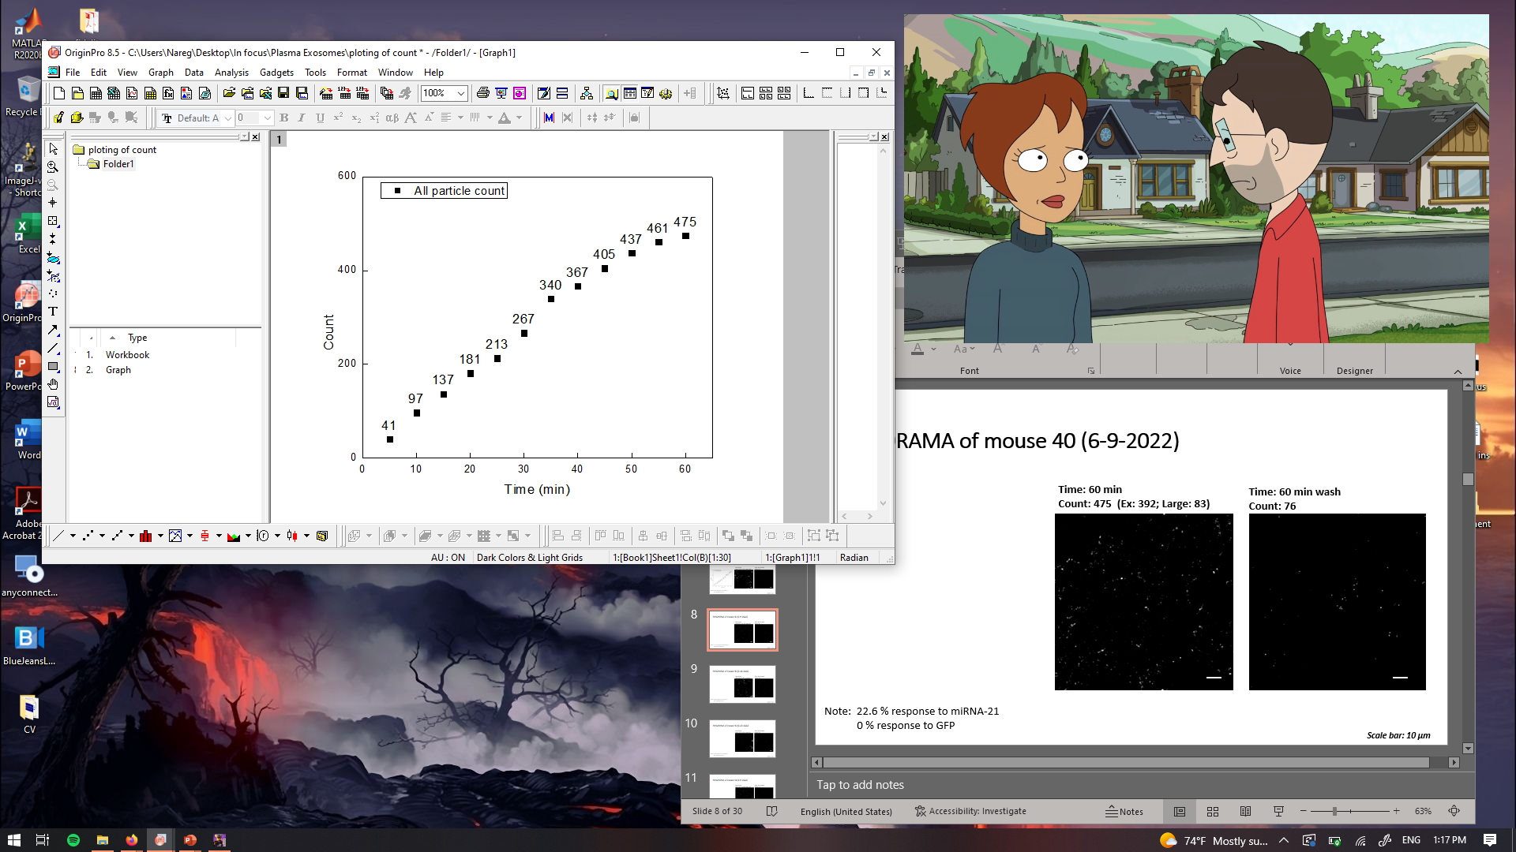

PANORAMA of mouse 40 (6-9-2022)
Time: 60 min
Count: 475 (Ex: 392; Large: 83)
Time: 60 min wash
Count: 76
Note: 22.6 % response to miRNA-21
0 % response to GFP
Scale bar: 10 µm

Slide 9
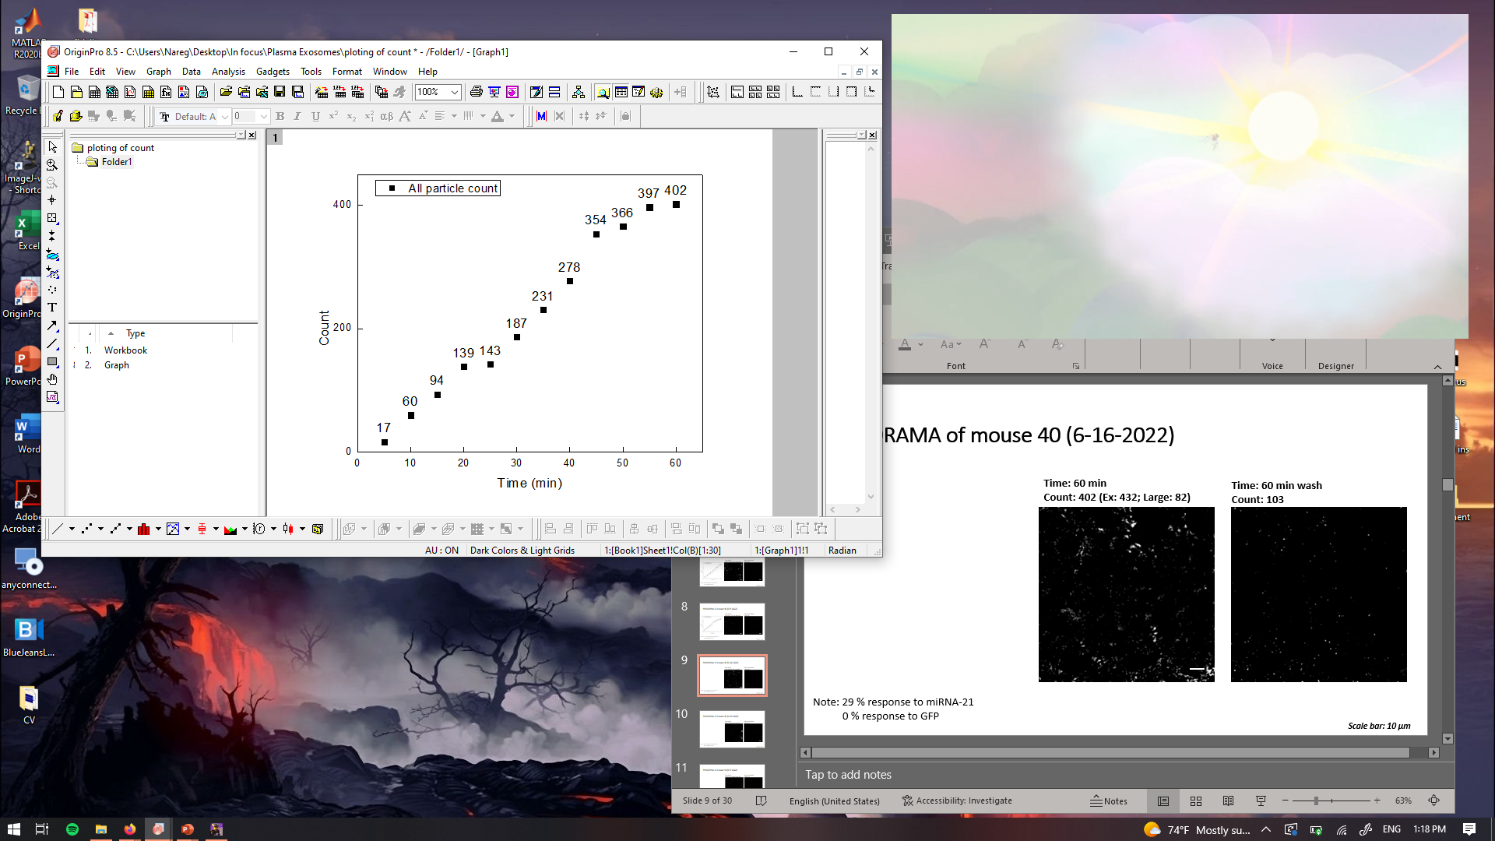

PANORAMA of mouse 40 (6-16-2022)
Time: 60 min
Count: 402 (Ex: 432; Large: 82)
Time: 60 min wash
Count: 103
Note: 29 % response to miRNA-21
0 % response to GFP
Scale bar: 10 µm

Slide 10
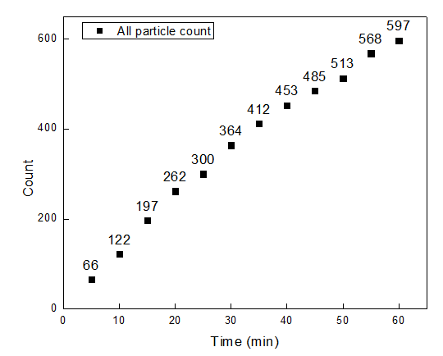
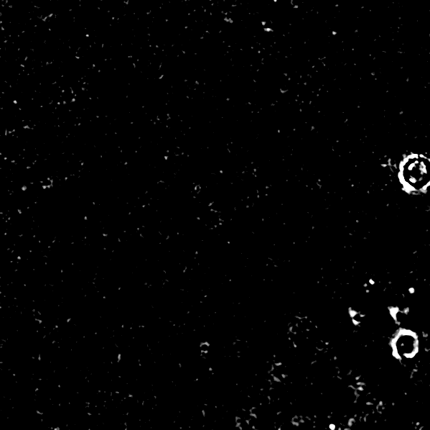

PANORAMA of mouse 40 (6-23-2022)
Time: 60 min
Count: 597 (Ex: 539; Large: 58)
Time: 60 min wash
Count: 122
Note: 13 % response to miRNA-21
4 % response to GFP
Scale bar: 10 µm

Slide 11
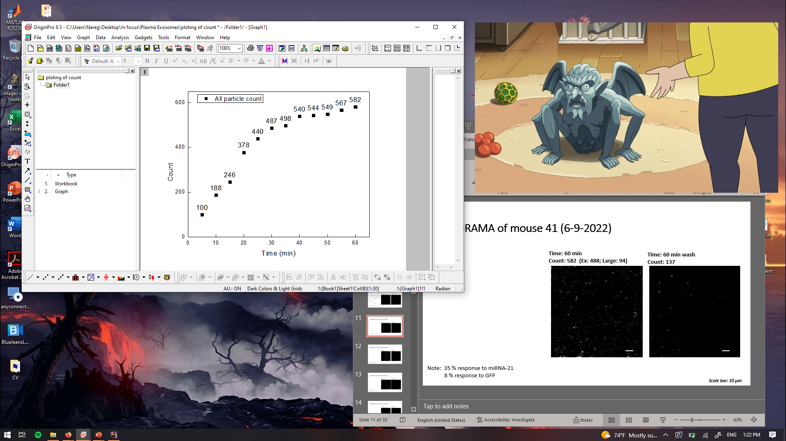
PANORAMA of mouse 41 (6-9-2022)
Time: 60 min
Count: 582 (Ex: 488; Large: 94)
Time: 60 min wash
Count: 137
Note: 35 % response to miRNA-21
8 % response to GFP
Scale bar: 10 µm

Slide 12
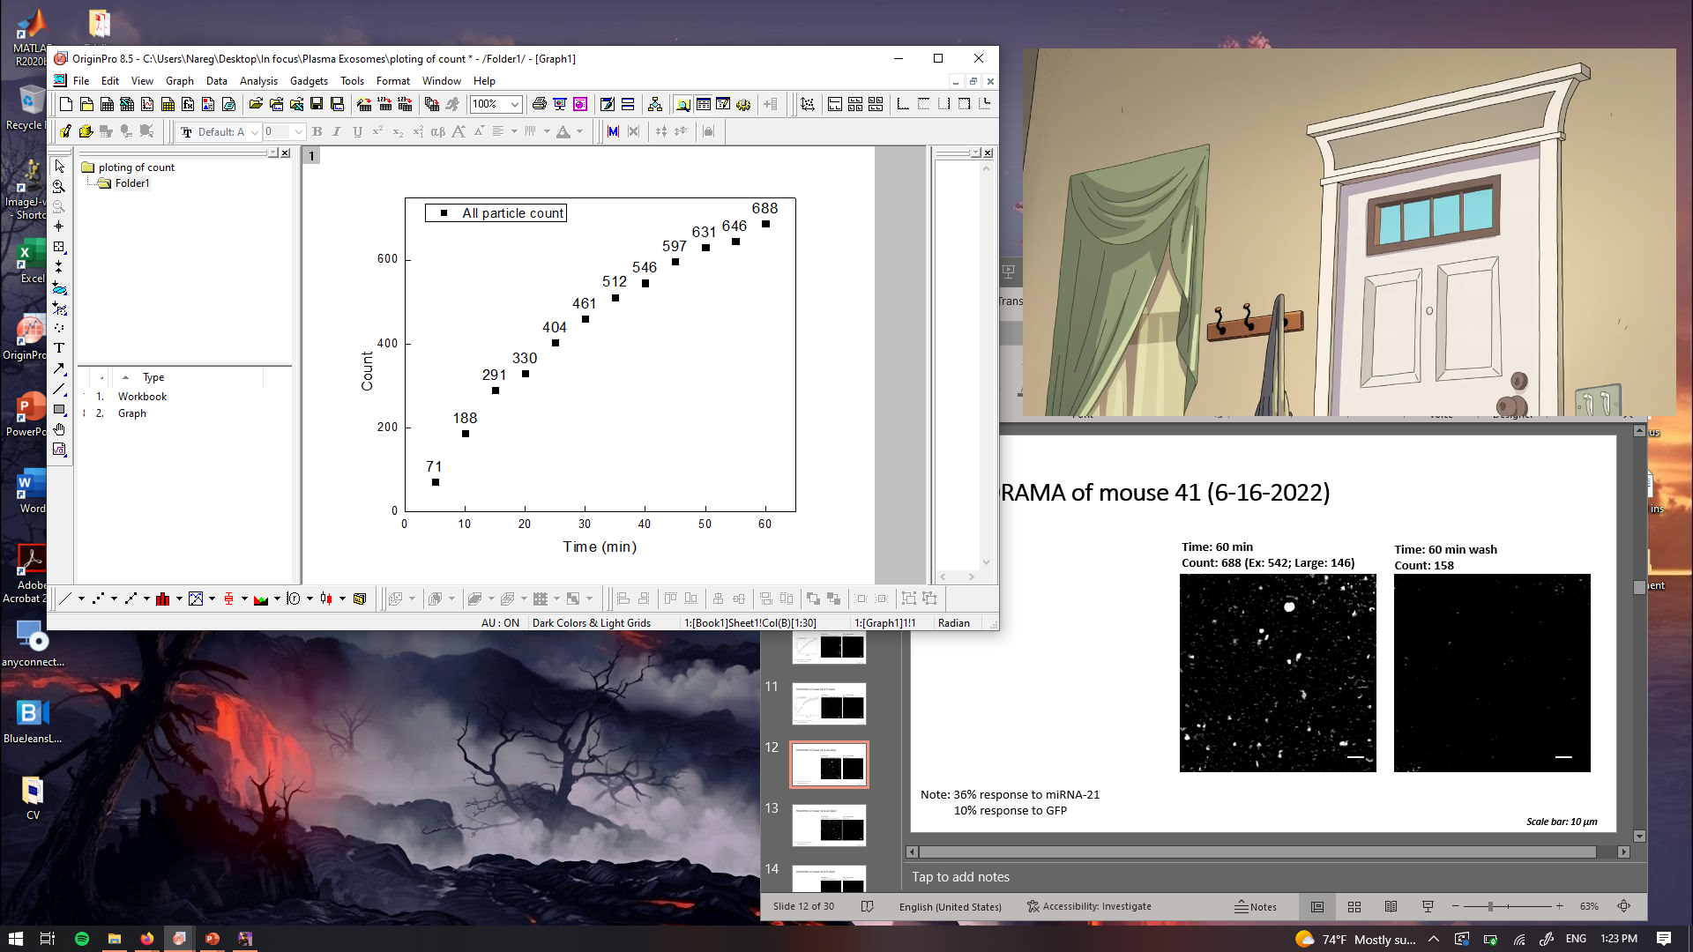
PANORAMA of mouse 41 (6-16-2022)
Time: 60 min
Count: 688 (Ex: 542; Large: 146)
Time: 60 min wash
Count: 158
Note: 36% response to miRNA-21
10% response to GFP
Scale bar: 10 µm

Slide 13
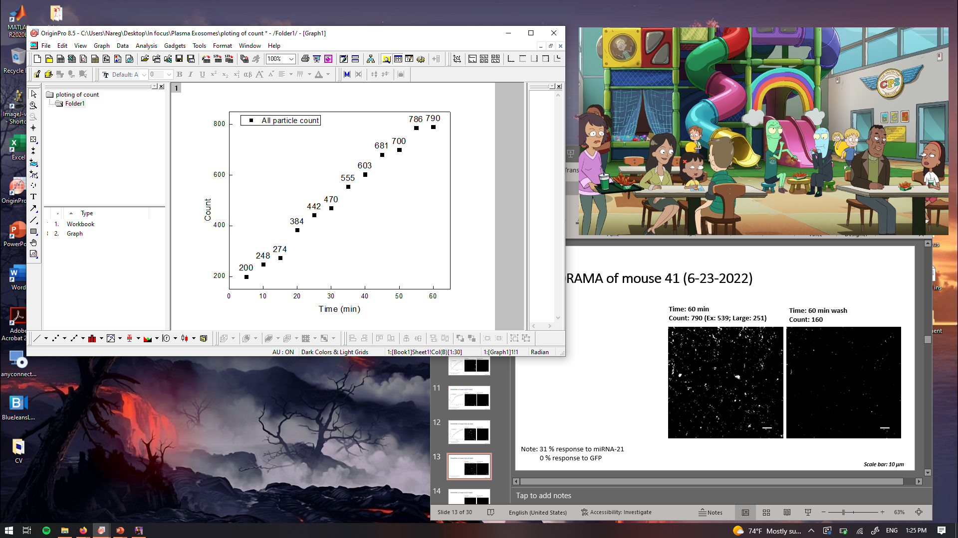

PANORAMA of mouse 41 (6-23-2022)
Time: 60 min
Count: 790 (Ex: 539; Large: 251)
Time: 60 min wash
Count: 160
Note: 31 % response to miRNA-21
0 % response to GFP
Scale bar: 10 µm

Slide 14
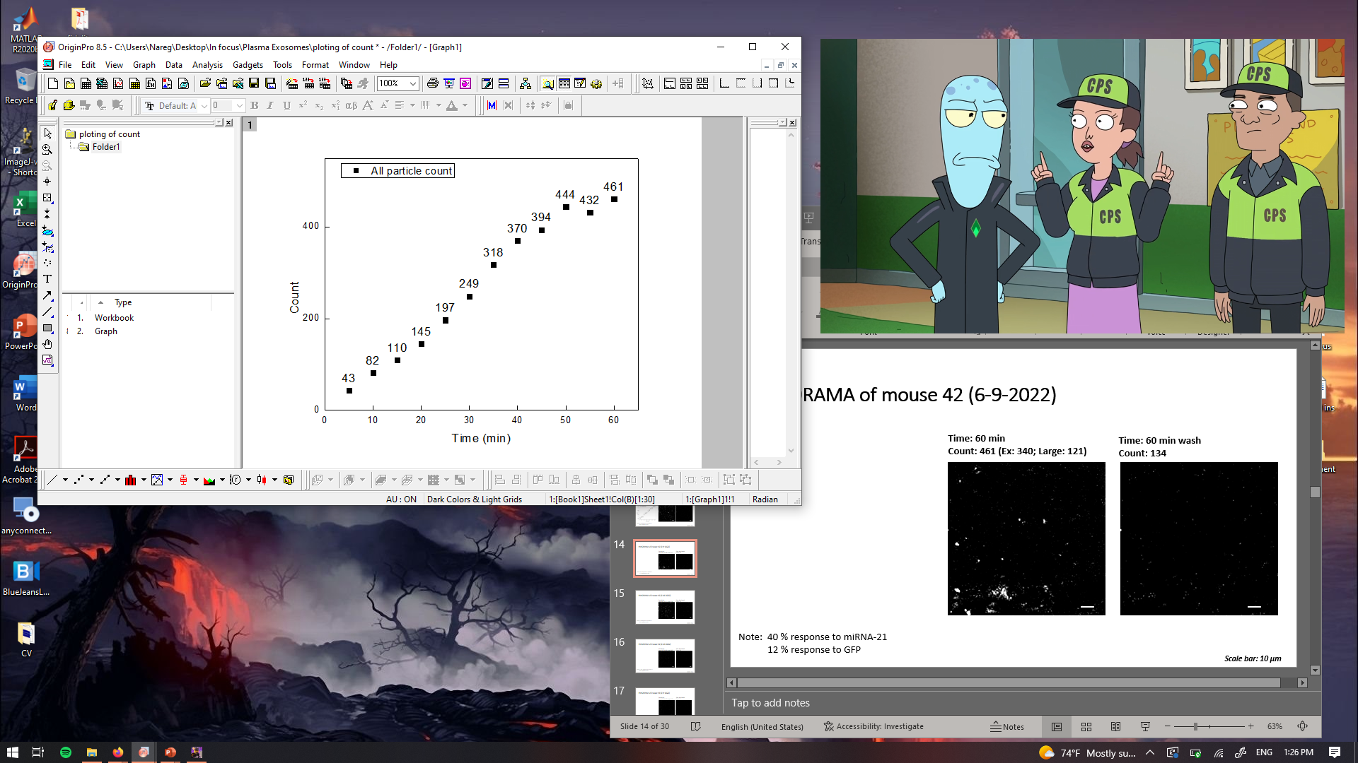
PANORAMA of mouse 42 (6-9-2022)
Time: 60 min
Count: 461 (Ex: 340; Large: 121)
Time: 60 min wash
Count: 134
Note: 40 % response to miRNA-21
12 % response to GFP
Scale bar: 10 µm

Slide 15
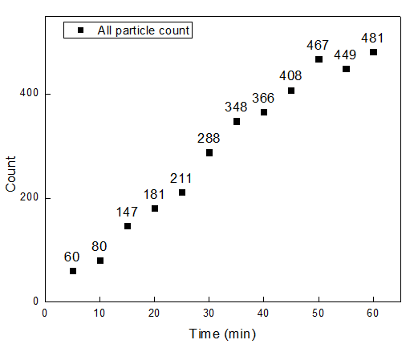
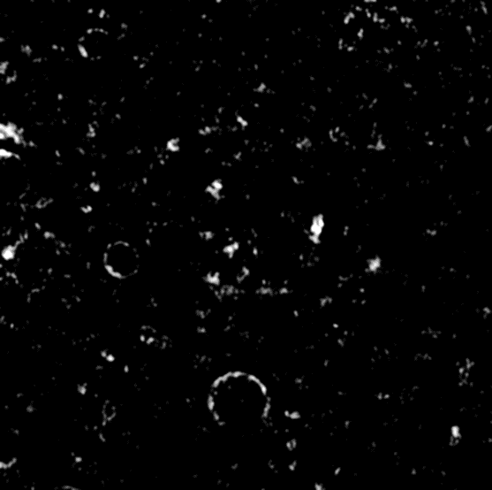

PANORAMA of mouse 42 (6-16-2022)
Time: 60 min
Count: 481 (Ex: 311; Large: 170)
Time: 60 min wash
Count: 159
Note: 22 % response to miRNA-21
5 % response to GFP
Scale bar: 10 µm

